Slide 1

GT03: Group Testing for general $d$ Non-adaptive randomized algorithm
Bounds on the number of tests in non-adaptive randomized Group Testing*
[*] Nader H. Bshouty, George Haddad, and Catherine A. Haddad-Zaknoon. Bounds for the number of tests in non-adaptive randomized algorithms for group testing, SOFSEM 2020, Limassol, Cyprus, January 20-24, Proceedings, volume 12011 of Lecture Notes in Computer Science, pages 101–112. Springer, 2020

Slide 2

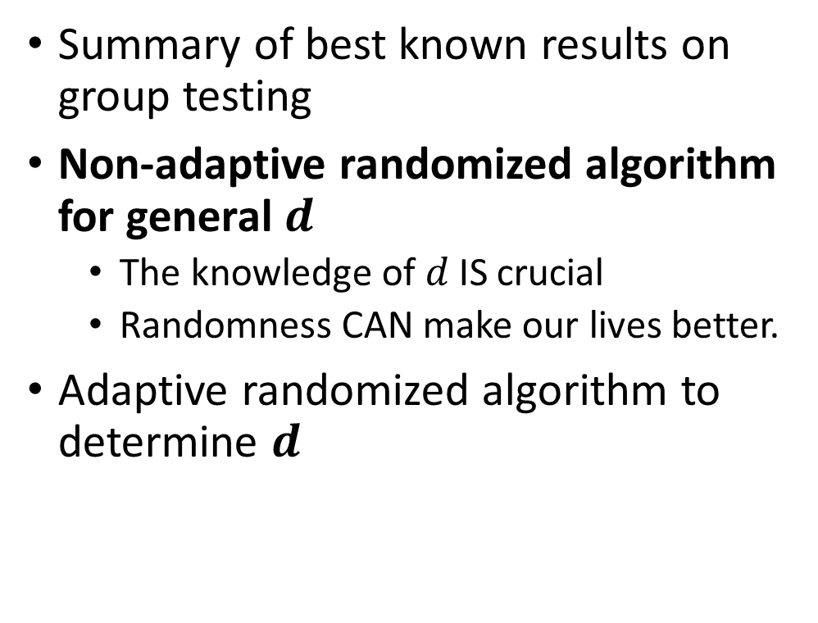
Our agenda
Summary of best known results on group testing
Non-adaptive randomized algorithm for general $d$
The knowledge of $d$ IS crucial
Randomness CAN make our lives better.
Adaptive randomized algorithm to determine $d$

Slide 3
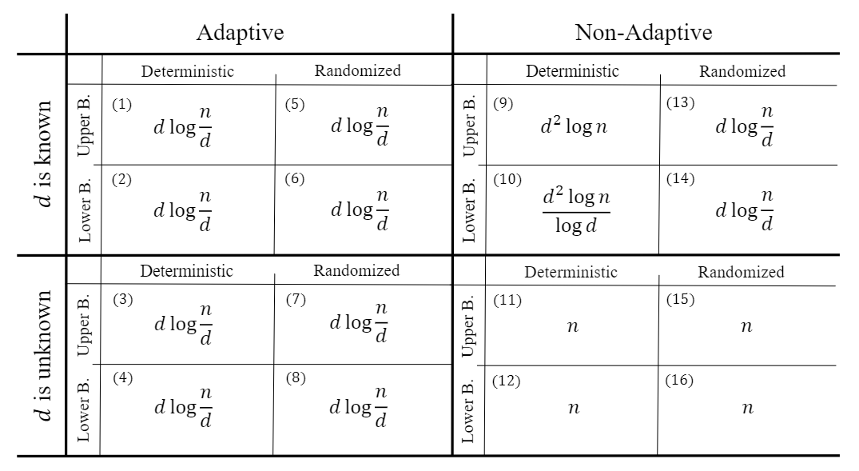

Known results on GT problem
Due to Hwang 1972
Notice how randomness reduces the test complexity
We cannot do better if d is unknown
Estimate d, then use the above $↑$ algorithms

Slide 4
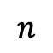
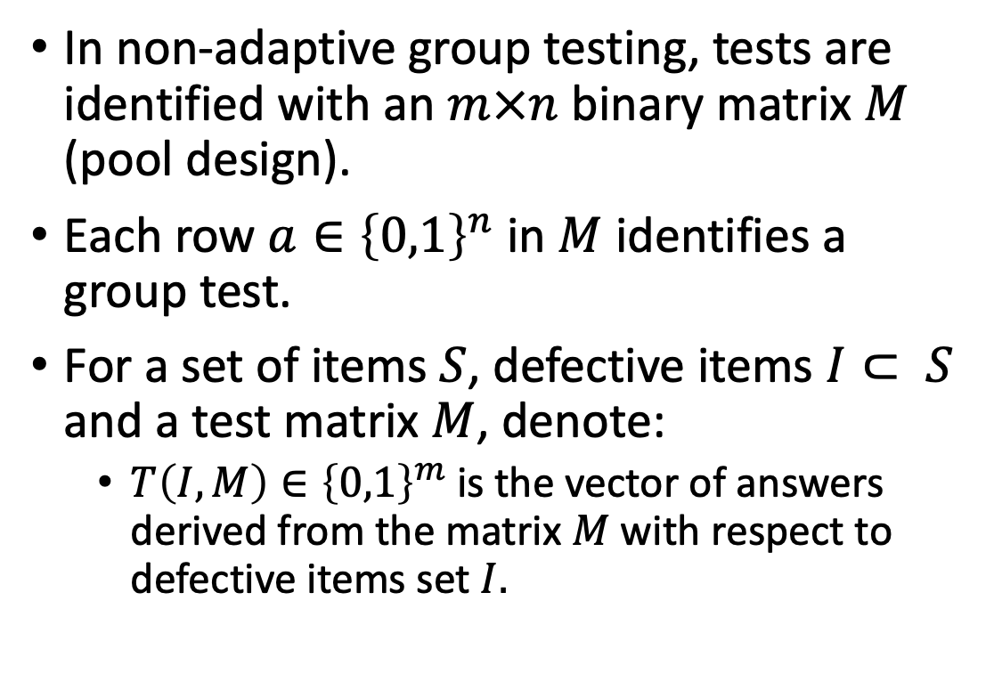
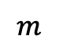
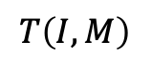
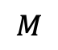
Finding the defective set: the test matrix (pool design)
In non-adaptive group testing, tests are identified with an $m×n$ binary matrix $M$ (pool design).
Each row $a∈{\left\{0,1\right\}}^{n}$ in $M$ identifies a group test.
For a set of items $S$, defective items $I⊂ S$ and a test matrix $M$, denote:
$T\left(I,M\right)∈{\left\{0,1\right\}}^{m}$ is the vector of answers derived from the matrix $M$ with respect to defective items set $I.$
$$n$$
$$m$$
$$M$$
$$T\left(I,M\right)$$

Slide 5
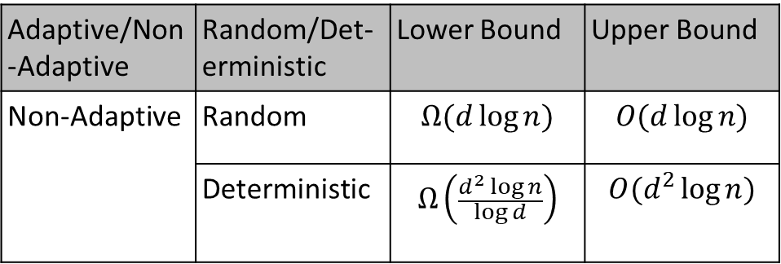
Random vs. Deterministic Non adaptive Algorithms for GT
In practice, tests are time consuming, therefore, non-adaptive algorithms are highly desired.
Lower bound for non-adaptive deterministic vs. non-adaptive random algorithm motivates the interest in non-adaptive random algorithms.
In many studies, optimality in the number of tests is “chased” up to the leading constant.
Adaptive/Non-Adaptive | Random/Det-erministic | Lower Bound | Upper Bound
Non-Adaptive | Random | $$Ω(d\log{n)}$$ | $$O(d\log{n)}$$
 | Deterministic | $$Ω\left(\frac{d^{2}\log{n}}{\log{d}}\right)$$ | $$O(d^{2}\log{n)}$$
Notes:
In practice, tests are time consuming and therefore nonadaptive algorithms are highly desired. Where by non-adaptive algorithm we mean that the tests are independent, that is, the decision of making a specific test does not involve the results of previous tests.
In the table we summarize the known lower and upper bound on the number of tests required to identify at most d defectives. And we can see the advantage of the random non-adaptive algorithms over the deterministic ones… this actually motivates our interest in non-adaptive random algorithms for GT.
Practically, the tests might take one-two days till getting the results, therefore, many studies including ours, focus their efforts on reducing the hidden constants in the O and omega notations.

Slide 6
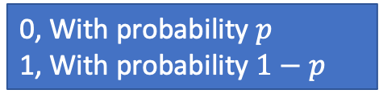
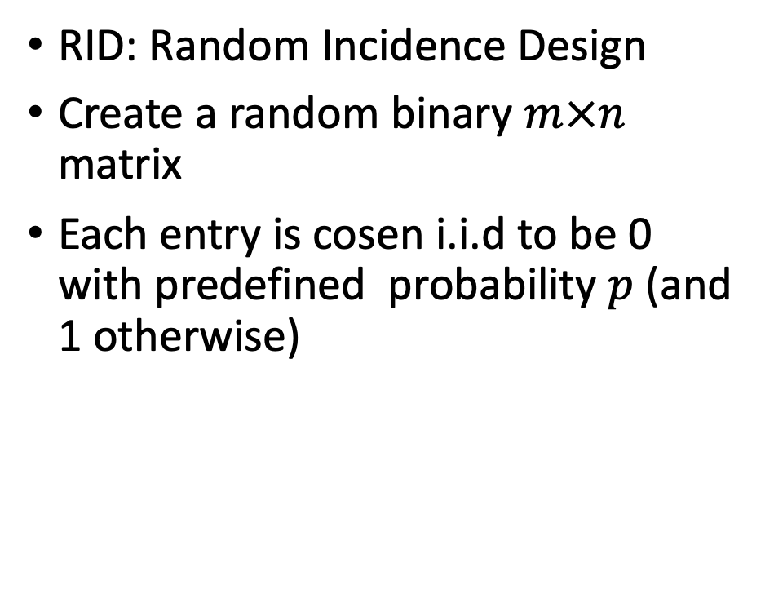
Pool Design Models: RID
RID
RID: Random Incidence Design
Create a random binary $m×n$ matrix
Each entry is cosen i.i.d to be 0 with predefined probability $p$ (and 1 otherwise)
 | …
 | …
. .
 | …
0, With probability $p$
1, With probability $1−p$

Slide 7
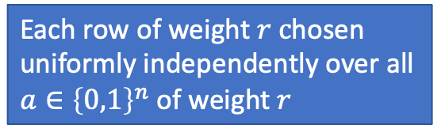
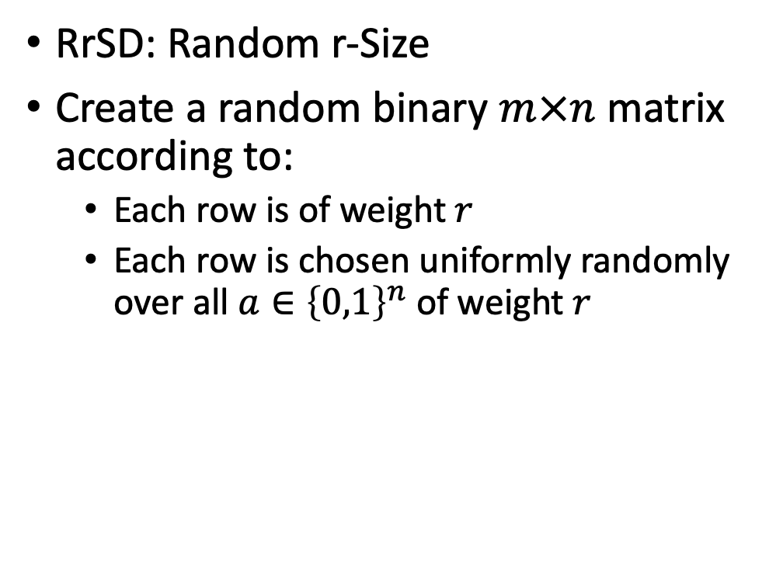
Pool Design Models: RrSD
RrSD: Random r-Size
Create a random binary $m×n$ matrix according to:
Each row is of weight$r$
Each row is chosen uniformly randomly over all $a∈{\left\{0,1\right\}}^{n}$ of weight $r$
RrSD
. .
Each row of weight $r c$hosen uniformly independently over all $a∈{\left\{0,1\right\}}^{n}$ of weight $r$

Slide 8
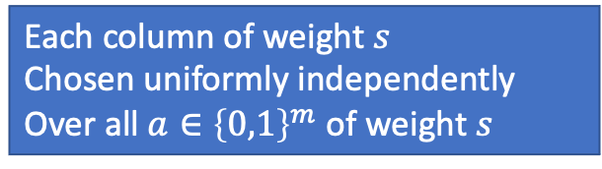
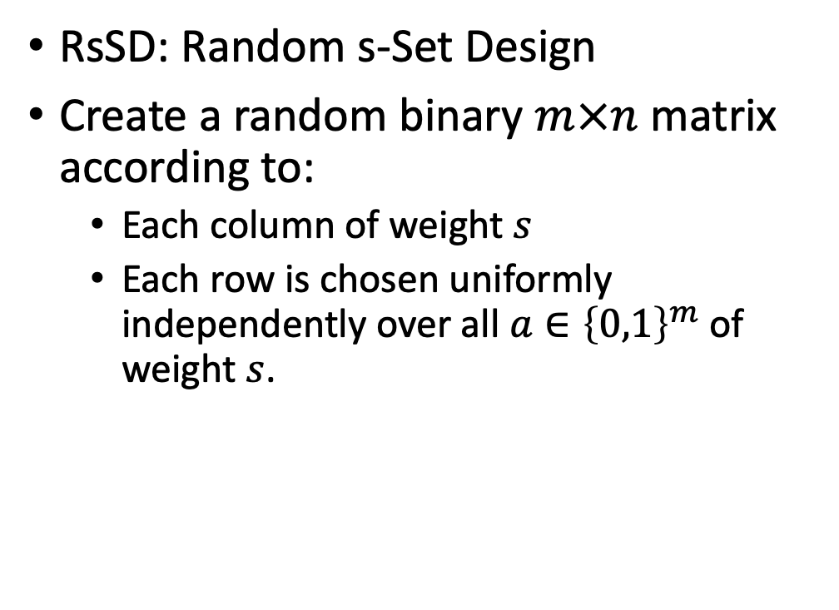
Pool Design Models: RsSD
RsSD
RsSD: Random s-Set Design
Create a random binary $m×n$ matrix according to:
Each column of weight $s$
Each row is chosen uniformly independently over all $a∈{\left\{0,1\right\}}^{m}$ of weight $s$.
 | … |  | …
Each column of weight $s$
Chosen uniformly independently
Over all $a∈{\left\{0,1\right\}}^{m}$ of weight $s$

Slide 9
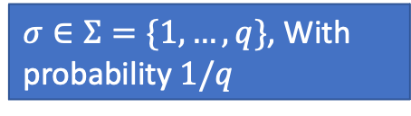
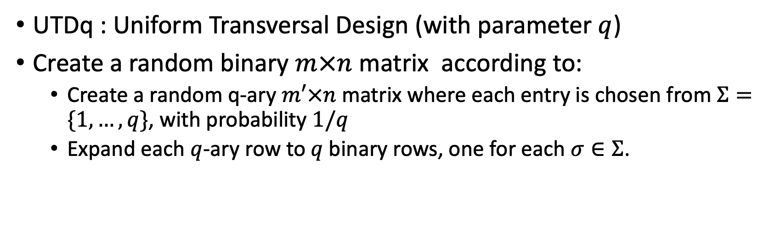
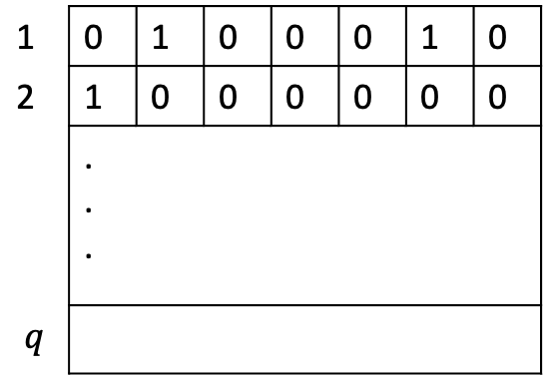
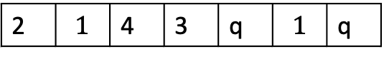
Pool Design Models: UTDq
UTDq : Uniform Transversal Design (with parameter $q$)
Create a random binary $m×n$ matrix according to:
Create a random q-ary $m′×n$ matrix where each entry is chosen from $Σ=\{1,…, q\}$, with probability $1/q$
Expand each $q$-ary row to $q$binary rows, one for each $σ∈Σ$.
UTDq
1 | 0 | 1 | 0 | 0 | 0 | 1 | 0
2 | 1 | 0 | 0 | 0 | 0 | 0 | 0
 | . . .
$$q$$
 | …
 | …
. .
 | …
$σ∈Σ=\{1,…, q\}$, With probability $1/q$
2 | $$1$$ | 4 | 3 | q | $$1$$ | q

Slide 10
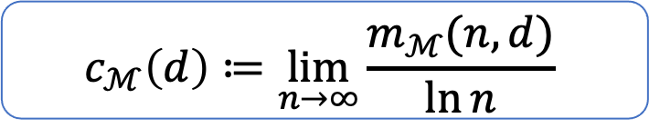
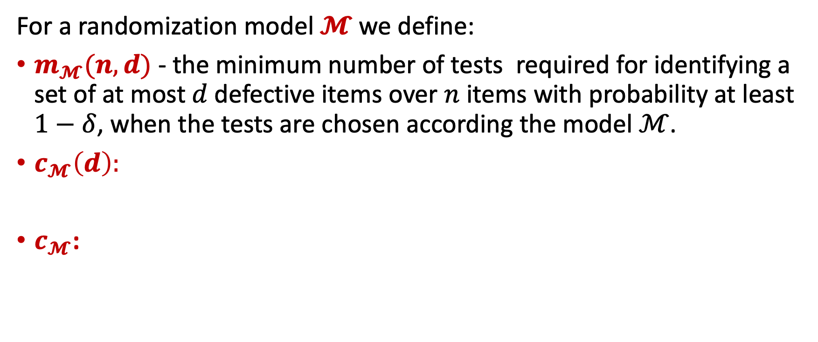


Objective
For a randomization model $𝓜$ we define:
$m_{𝓜}(n,d)$ - the minimum number of tests required for identifying a set of at most$d$defective items over $n$ items with probability at least $1−δ$, when the tests are chosen according the model $ℳ$.
$c_{𝓜}\left(d\right):$
$c_{𝓜}$:
$$c_{ℳ}\left(d\right)≔\lim_{n→∞}{\frac{m_{ℳ}(n,d)}{\ln{n}}}$$
$$c_{ℳ}≔\lim_{d→∞}{\frac{c_{ℳ}(d)}{d}}$$
Our objective is to study the constant $c_{ℳ}$ over the models RID, RrSD, RsSD and UTDq

Slide 11

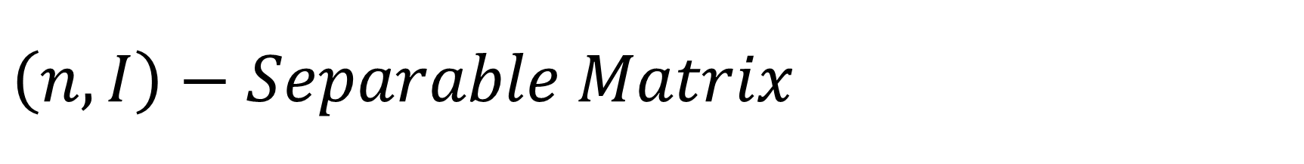
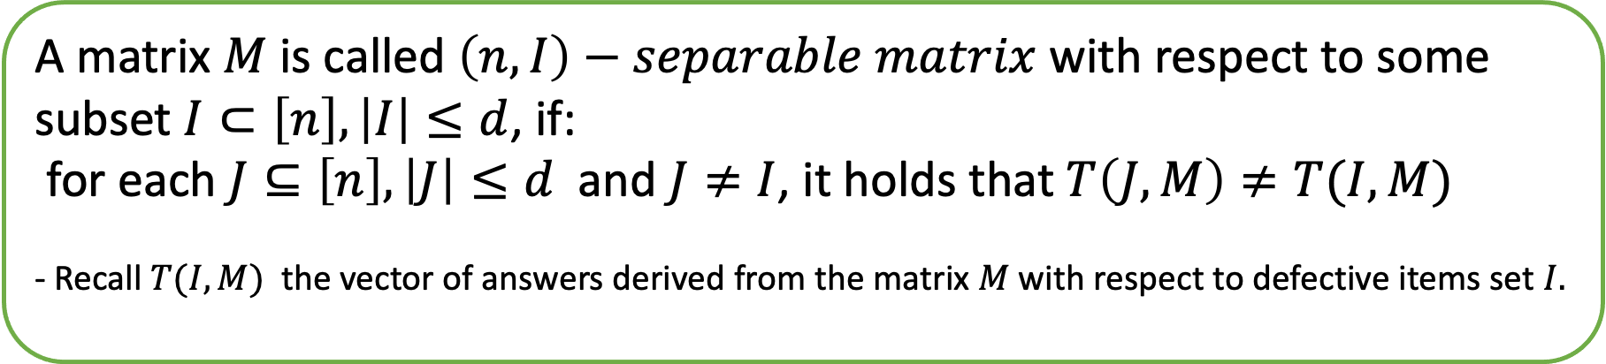
$$\left(n,I\right)−Separable Matrix$$
A matrix $M$ is called $\left(n,I\right)−separable matrix$ with respect to some subset $I⊂\left[n\right], \left|I\right|≤d$, if:
for each $J⊆\left[n\right], \left|J\right|≤d$ and $J≠I$, it holds that $T\left(J,M\right)≠T(I,M)$
- Recall $T(I,M)$ the vector of answers derived from the matrix $M$ with respect to defective items set $I.$
That is, the only set of up to $d$ elements that is consistent with the answers of $M$ is $I$.
This property is hard to analyze!!!

Slide 12
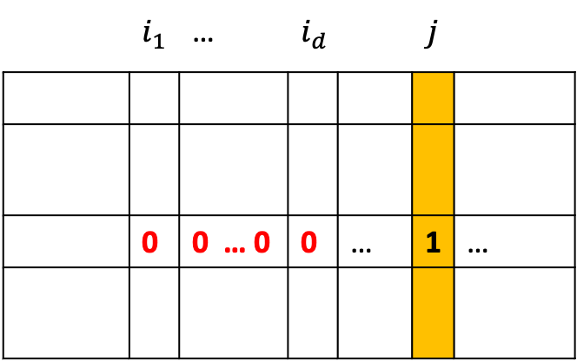
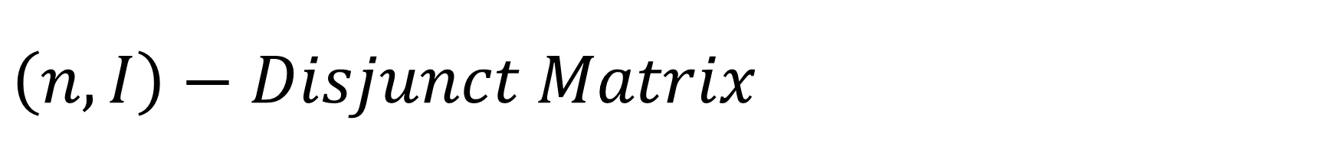

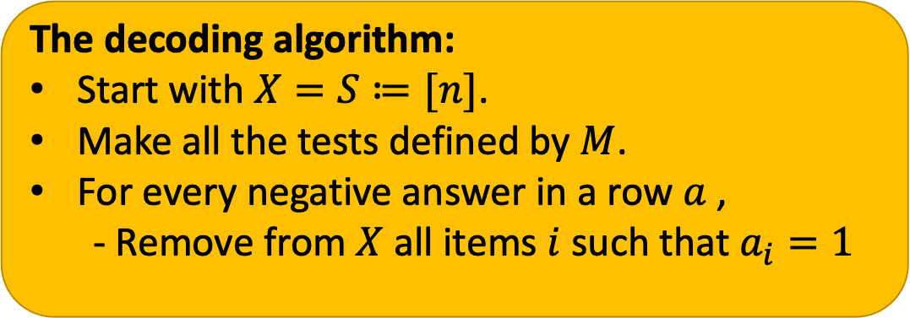
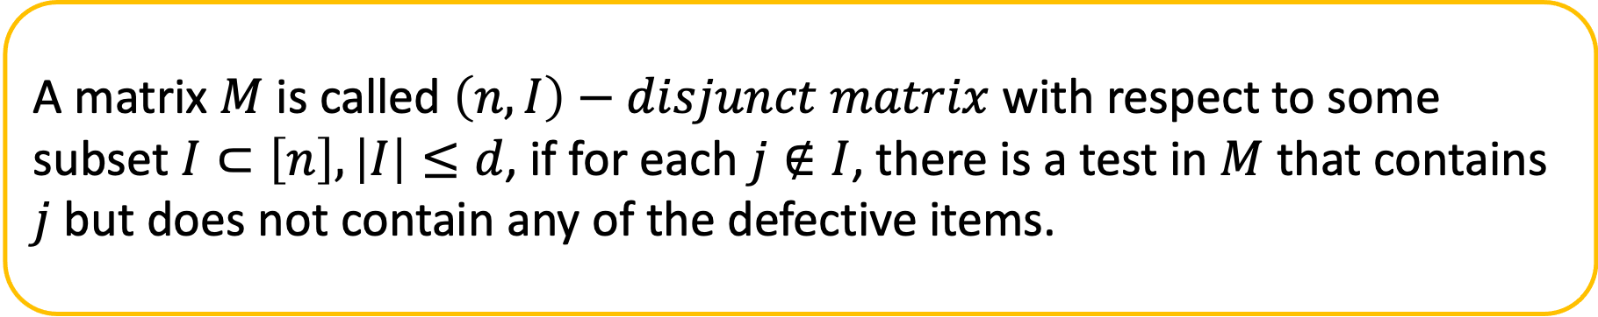
$$\left(n,I\right)−Disjunct Matrix$$
A matrix $M$ is called $\left(n,I\right)−disjunct matrix$ with respect to some subset $I⊂\left[n\right], \left|I\right|≤d$, if for each $j∉I$, there is a test in $M$ that contains $j$ but does not contain any of the defective items.
The decoding algorithm:
Start with $X=S≔[n]$.
Make all the tests defined by $M$.
For every negative answer in a row $a$ ,
- Remove from $X$ all items $i$ such that $a_{i}=1$
 | $$i_{1}$$ | … | $$i_{d}$$ |  | $$j$$
 | 0 | 0 … 0 | 0 | … | 1 | …
Such test guarantees to eliminate $j$ from $X$.

Slide 13
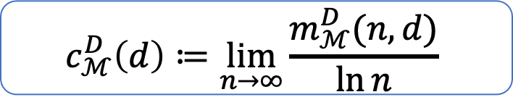
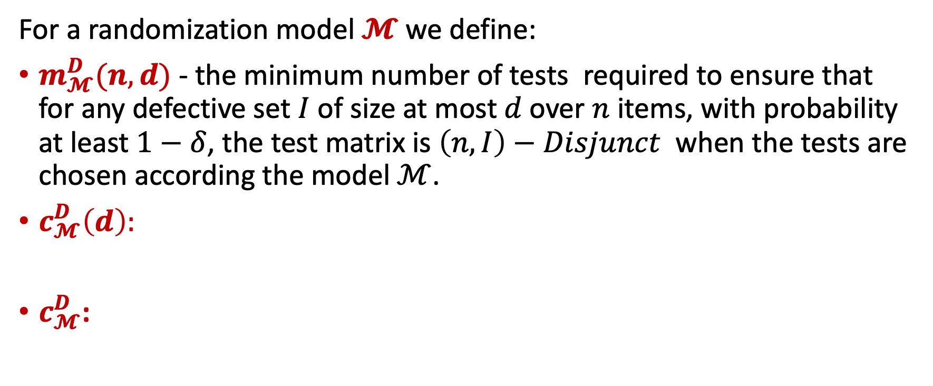


Disjunct matrices parameters
For a randomization model $𝓜$ we define:
$m_{𝓜}^{D}(n,d)$ - the minimum number of tests required to ensure that for any defective set $I$ of size at most$d$over $n$ items, with probability at least $1−δ$, the test matrix is $\left(n,I\right)−Disjunct$ when the tests are chosen according the model $ℳ$.
$c_{𝓜}^{D}\left(d\right):$
$c_{𝓜}^{D}$:
$$c_{ℳ}^{D}\left(d\right)≔\lim_{n→∞}{\frac{m_{ℳ}^{D}(n,d)}{\ln{n}}}$$
$$c_{ℳ}^{D}≔\lim_{d→∞}{\frac{c_{ℳ}^{D}(d)}{d}}$$
We will study the constant $c_{ℳ}$ over the previous models via the constant $c_{ℳ}^{D}$

Slide 14
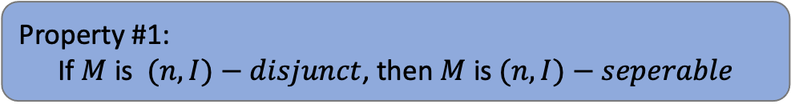
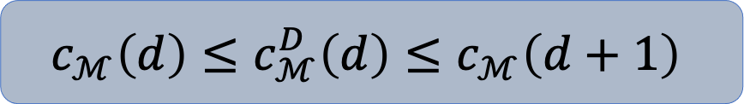

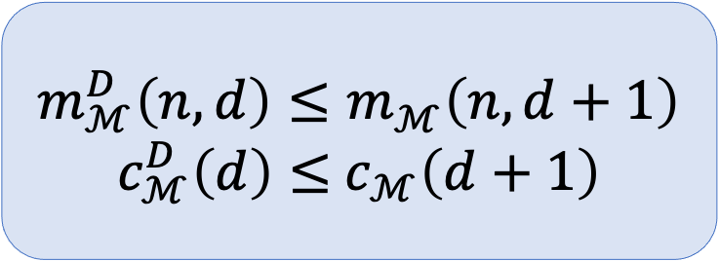
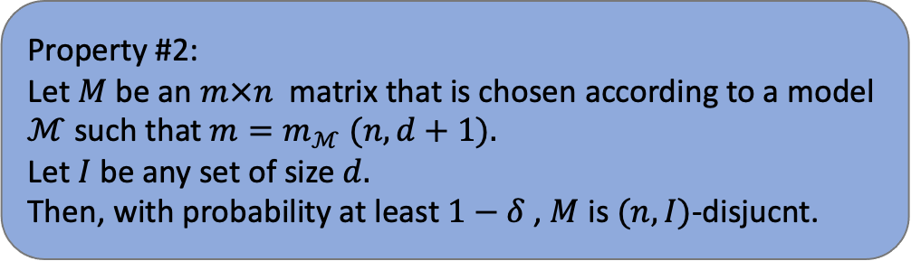

Disjunct vs. Seperable: why $c_{ℳ}^{D}$ is good enough?
Property #1:
If $M$ is $(n,I)−disjunct$, then $M$ is $(n,I)−seperable$
$$c_{ℳ}\left(d\right)≤c_{ℳ}^{D}\left(d\right)$$
Property #2:
Let $M$ be an $m×n$ matrix that is chosen according to a model $ℳ$ such that $m=m_{ℳ} (n,d+1).$
Let $I$ be any set of size $d.$
Then, with probability at least $1−δ$ , $M$ is $(n,I)$-disjucnt.
$$m_{ℳ}^{D}\left(n,d\right)≤m_{ℳ}^{}\left(n,d+1\right)$$
$c_{ℳ}^{D}\left(d\right)≤$ $c_{ℳ}\left(d+1\right)$
$$c_{ℳ}\left(d\right)≤c_{ℳ}^{D}\left(d\right)≤c_{ℳ}\left(d+1\right)$$
$c_{ℳ}\left(d+1\right), c_{ℳ}\left(d\right)=O\left(d\right)⇒$ $c_{ℳ}=c_{ℳ}^{D}$

Slide 15
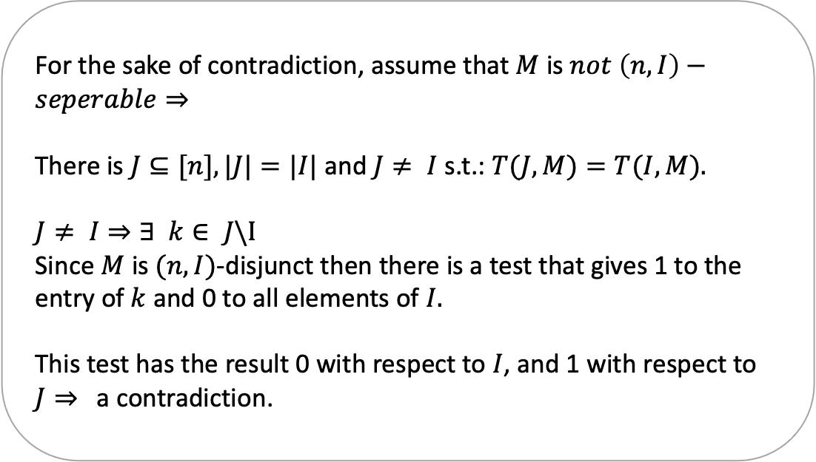
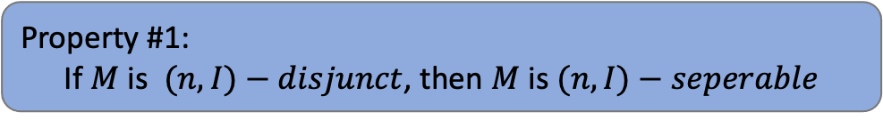
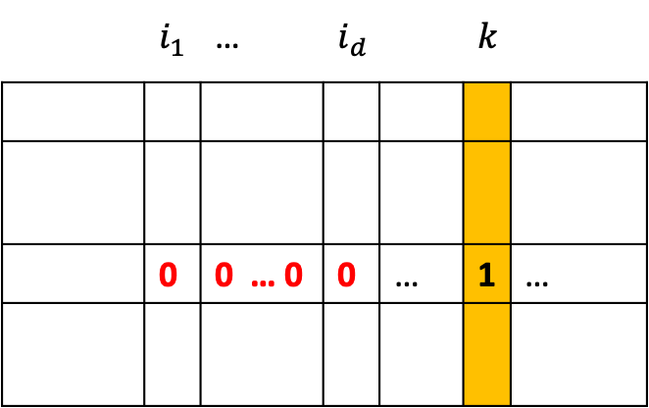
Disjunctivity vs. Seperability
 | $$i_{1}$$ | … | $$i_{d}$$ |  | $$k$$
 | 0 | 0 … 0 | 0 | … | 1 | …
Property #1:
If $M$ is $(n,I)−disjunct$, then $M$ is $(n,I)−seperable$
For the sake of contradiction, assume that $M$ is $not \left(n,I\right)−seperable⇒$
There is $J⊆[n],|J|=|I|$and $J≠ I$s.t.: $T(J,M)=T(I,M).$
$$J≠ I⇒∃ k∈ J\backslash I$$
Since $M$ is $(n, I)$-disjunct then there is a test that gives 1 to the entry of $k$ and 0 to all elements of $I.$
This test has the result 0 with respect to $I$, and 1 with respect to $J⇒$ a contradiction.

Slide 16
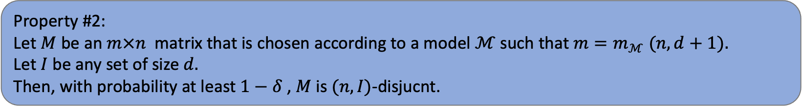
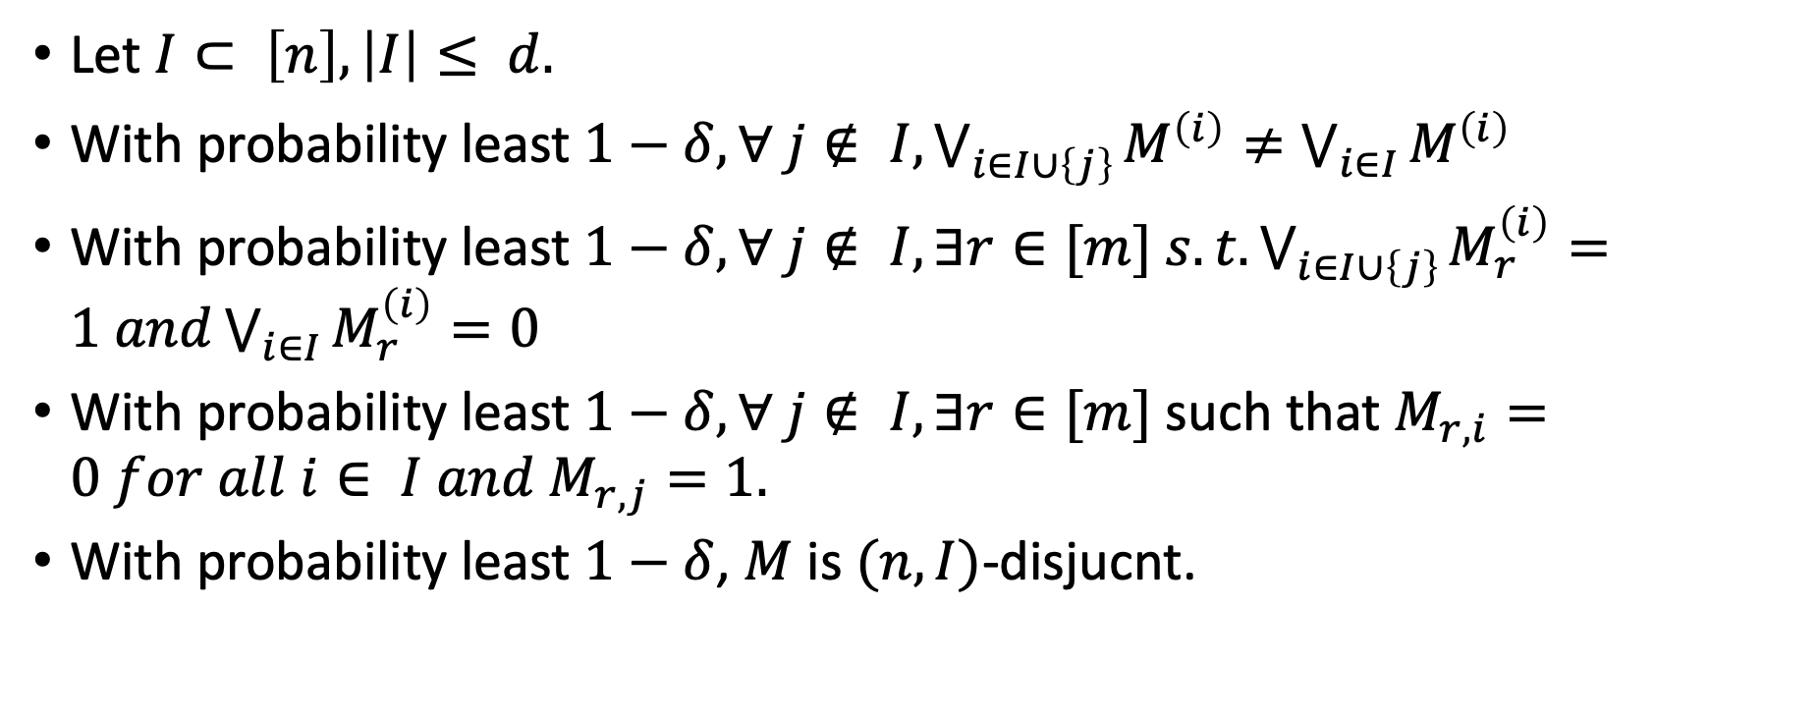
Disjunctivity vs. Seperability
Property #2:
Let $M$ be an $m×n$ matrix that is chosen according to a model $ℳ$ such that $m=m_{ℳ} (n,d+1).$
Let $I$ be any set of size $d.$
Then, with probability at least $1−δ$ , $M$ is $(n,I)$-disjucnt.
Let $I⊂ \left[n\right], \left|I\right|≤ d.$
With probability least $1−δ, ∀ j∉ I, \bigvee_{i∈I∪\left\{j\right\}}{M^{\left(i\right)}}≠\bigvee_{i∈I}{M^{\left(i\right)}}$
With probability least $1−δ, ∀ j∉ I, ∃r∈[m] s.t.\bigvee_{i∈I∪\left\{j\right\}}{M_{r}^{\left(i\right)}}=1 and\bigvee_{i∈I}{M_{r}^{\left(i\right)}}=0$
With probability least $1−δ, ∀ j∉ I, ∃r∈[m]$ such that $M_{r,i}=0 for all i∈ I and M_{r,j}=1.$
With probability least $1−δ$, $M$ is $(n,I)$-disjucnt.

Slide 17
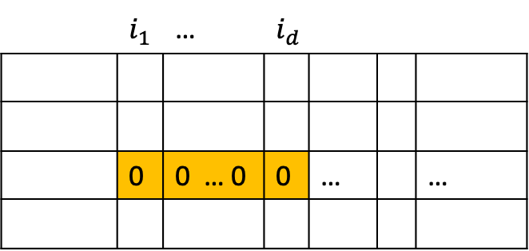
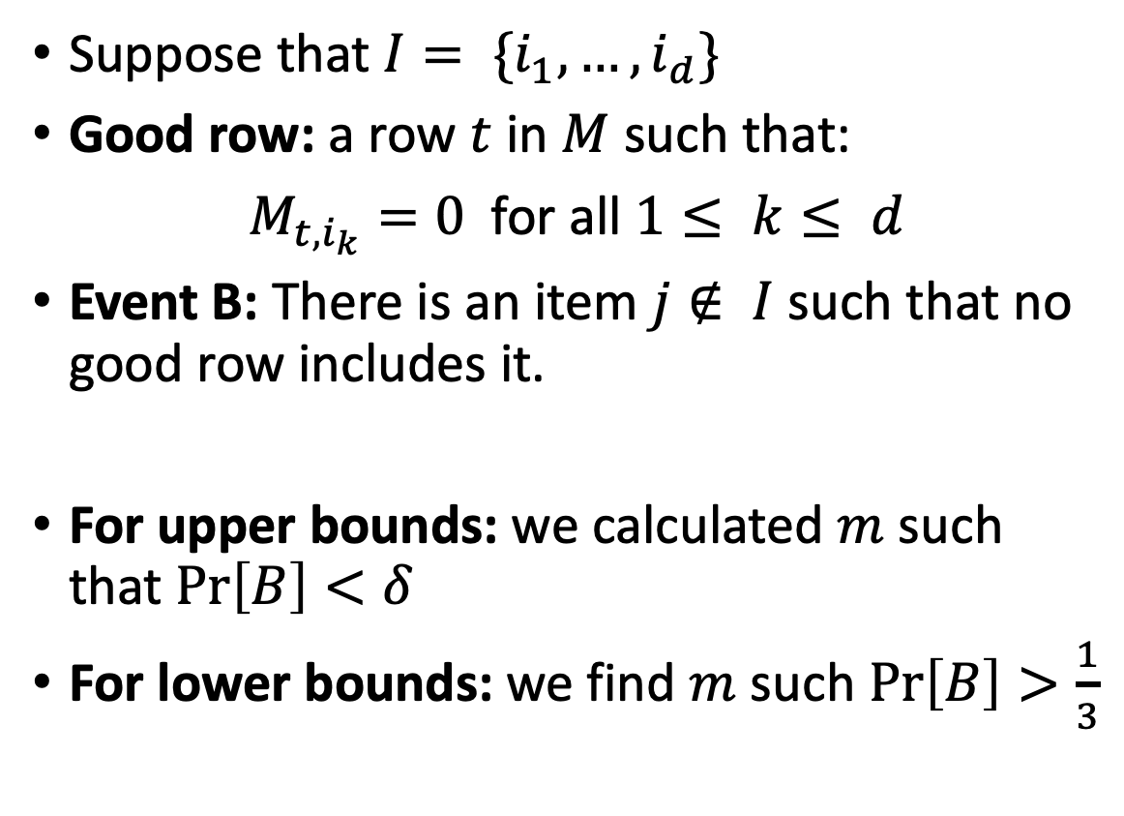
Good Rows
 | $$i_{1}$$ | … | $$i_{d}$$
 | 0 | 0 … 0 | 0 | … |  | …
Suppose that $I= \{i_{1}, …, i_{d}\}$
Good row: a row $t$ in $M$ such that:
$M_{t,i_{k}}=0$for all $1≤ k≤ d$
Event B: There is an item $j∉ I$such that no good row includes it.
For upper bounds: we calculated $m$ such that $\operatorname{Pr}\left[B\right]<δ$
For lower bounds: we find $m$ such $\operatorname{Pr}\left[B\right]>\frac{1}{3}$

Slide 18
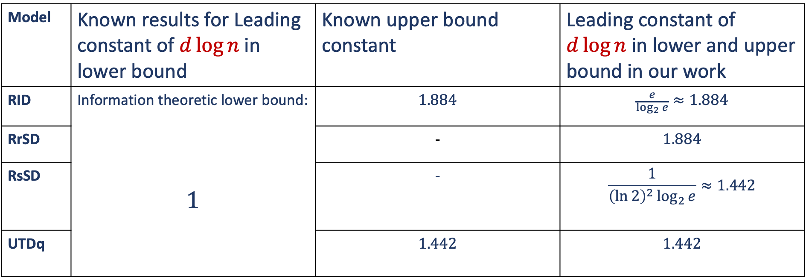
RrSD
Model | Known results for Leading constant of $d\log{n}$ in lower bound | Known upper bound constant | Leading constant of $d\log{n}$ in lower and upper bound in our work
RID | Information theoretic lower bound: $$1$$ | $$1.884$$ | $$\frac{e}{\log_{2}{e}}≈1.884$$
RrSD |  | - | $$1.884$$
RsSD |  | - | $$\frac{1}{{\left(\ln{2}\right)}^{2}\log_{2}{e}}≈1.442$$
UTDq |  | $$1.442$$ | $$1.442$$

Slide 19
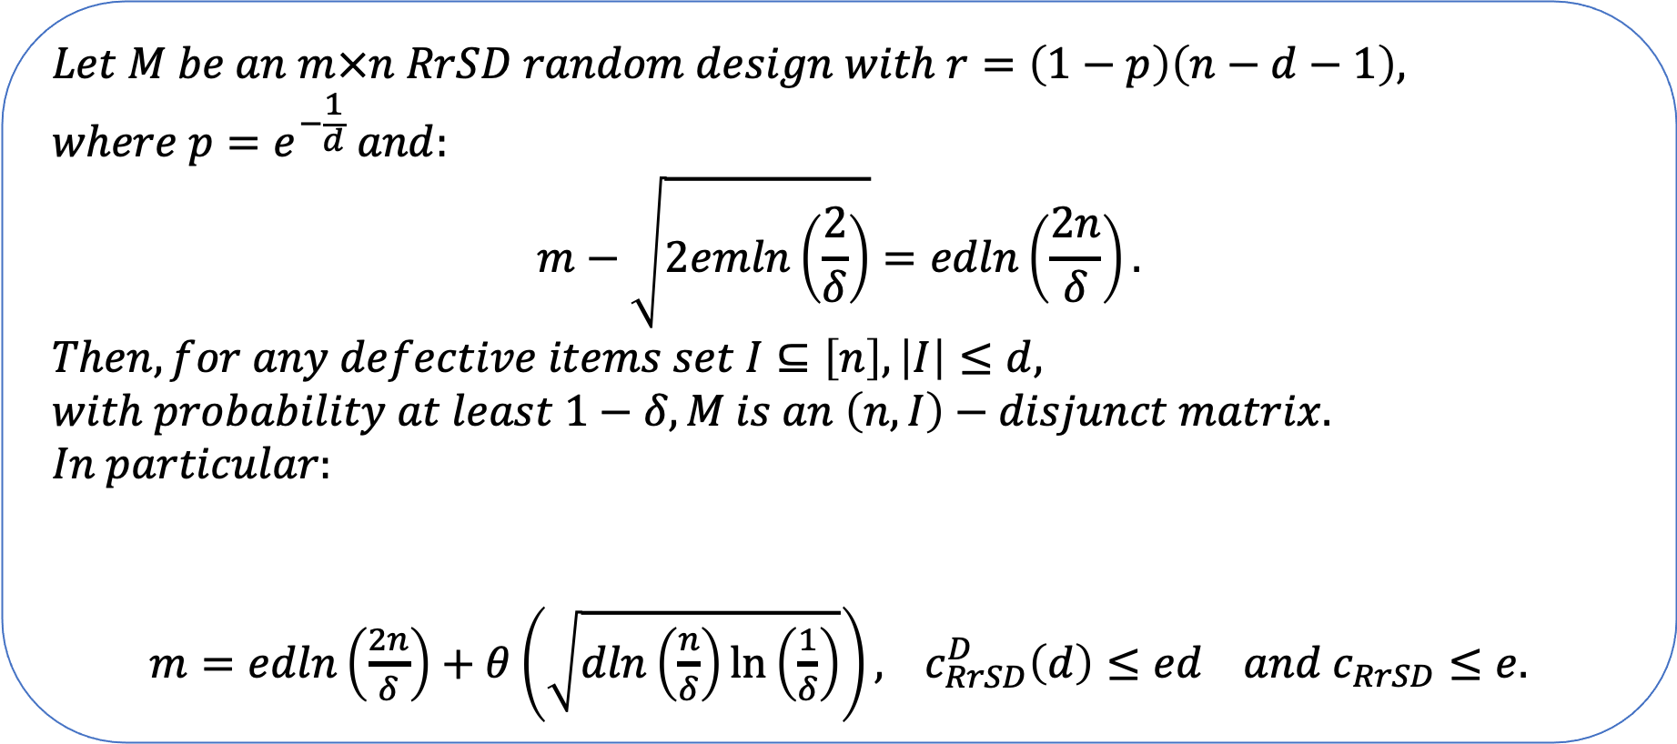
Upper bound lemma
$$Let M be an m×n RrSD random design with r=\left(1−p\right)\left(n−d−1\right), where p=e^{−\frac{1}{d}} and:$$
$$m−\sqrt{2emln\left(\frac{2}{δ}\right)}=edln\left(\frac{2n}{δ}\right).$$
$$Then, for any defective items set I⊆\left[n\right], \left|I\right|≤d, with probability at least 1−δ, M is an \left(n,I\right)−disjunct matrix.$$
$$In particular:$$
$m=edln\left(\frac{2n}{δ}\right)+θ\left(\sqrt{dln\left(\frac{n}{δ}\right)\ln\left(\frac{1}{δ}\right)}\right),$ $c_{RrSD}^{D}\left(d\right)≤ed and c_{RrSD}≤e.$

Slide 20
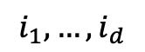
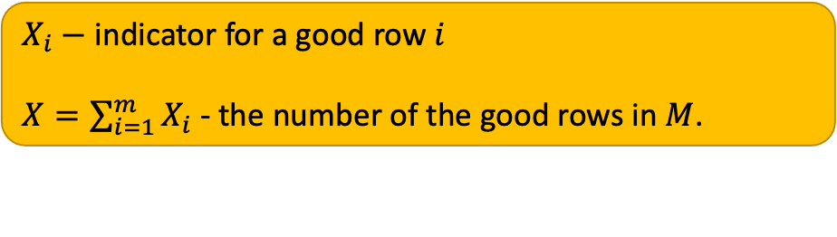
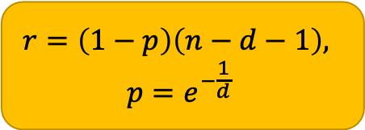
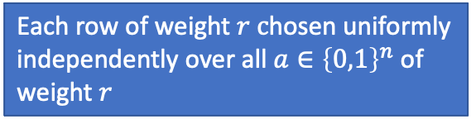
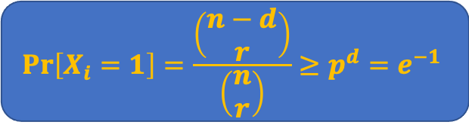


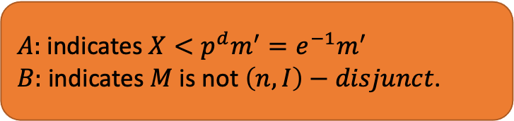
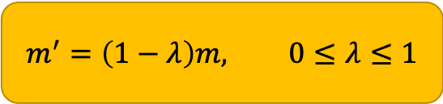

$X_{i}−$ indicator for a good row $i$
$X=\sum_{i=1}^{m}{X_{i}}$ - the number of the good rows in $M$.
RrSD
. .
$$m^{′}=\left(1−λ\right)m, 0≤λ≤1$$
$$λ=\left(1−\frac{m}{m^{′}}\right)$$
$$\operatorname{Pr}\left[X_{i}=1\right]=\frac{\left(\begin{matrix}n−d \\ r\end{matrix}\right)}{\left(\begin{matrix}n \\ r\end{matrix}\right)}≥p^{d}=e^{−1}$$
$$r=\left(1−p\right)\left(n−d−1\right),$$
$$p=e^{−\frac{1}{d}}$$
Each row of weight $r c$hosen uniformly independently over all $a∈{\left\{0,1\right\}}^{n}$ of weight $r$
$$μ≔E[X]≥mp^{d}={me}^{−1}$$
$$i_{1}, …, i_{d}$$
Events
$A:$ indicates $X<{p^{d}m}^{′}=e^{−1}m^{′}$
$B:$ indicates $M$ is not $\left(n,I\right)−disjunct$.
0 …. 0
Target
Find $m, m’$and $p$such that:
$$\operatorname{Pr}\left[B\right]≤\operatorname{Pr}\left[A\right]+\operatorname{Pr}\left[B | \overline{A }\right]<δ$$

Slide 21
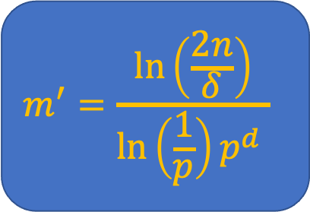
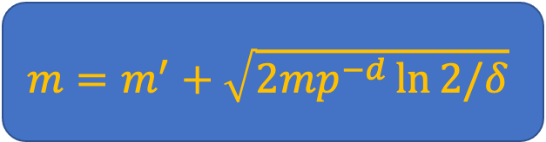






$$\operatorname{Pr}\left[A\right]<δ/2$$
$$\operatorname{Pr}\left[A\right]=\operatorname{Pr}\left[≤ m^{′}p^{d}\right]=\operatorname{Pr}\left[X≤\left(1−\left(1−\frac{m^{′}}{m}\right)\right)mp^{d}\right]≤…$$
$$…≤Pr\left[X≤\left(1−\left(1−\frac{m^{′}}{m}\right)\right)μ\right]≤…<e^{−\left({\left(1−\frac{m^{′}}{m}\right)}^{2}⋅\frac{m}{2}p^{d}\right)}=δ/2$$
$$m=m^{′}+\sqrt{2mp^{−d}\ln{2/δ}}$$
$$r=\left(1−p\right)\left(n−d−1\right)$$
$$\operatorname{Pr}\left[B | \overline{A }\right]<δ/2$$
$${{\operatorname{Pr}\left[B | \overline{A }\right]≤\left(n−d\right) {\left({\left(\begin{matrix}n−d−1 \\ r\end{matrix}\right) }/{\left(\begin{matrix}n−d \\ r\end{matrix}\right) }\right)}^{m^{′}p^{d}}≤n\left(1−\frac{r}{n−d} \right)}^{m^{′}p^{d}}≤n⋅p^{m^{′}p^{d}}=\frac{δ}{2}}^{}$$
$$m^{′}=\frac{\ln\left(\frac{2n}{δ}\right)}{\ln\left(\frac{1}{p}\right)p^{d} }$$
$$\min_{p}{m^{′}}⇒p=e^{−\frac{1}{d}}$$
$$m^{′}=ed\ln\left(\frac{2n}{δ}\right)$$

Slide 22

Lower bound lemma
$Let M be an m×n RrSD random design with 0≤r≤n, and d<n^{\frac{1}{2}}/\ln^{3}{n}$. If
$$m=ed\ln\left(\frac{n}{e}\right)−e^{3}\sqrt{3m},$$
$Then, with probability at least \frac{1}{3}$ ,$M is not \left(n,I\right)−disjunct matrix.$
$$In particular, to have success probability at least\frac{1}{3}we must have:$$
$m≥ed\ln{n}−Θ\left(d+\sqrt{d\ln{n}}\right)⇒$ $c_{RrSD}^{D}\left(d\right)≥ed and c_{RrSD}≥e.$

Slide 23








$X_{i}−$ indicator for a good row $i$
$X=\sum_{i=1}^{m}{X_{i}}$ - the number of the good rows in $M$.
$$i_{1}, …, i_{d}$$
$$m^{′}=\left(1+λ\right)m, 0≤λ≤1$$
$$m=m^{′}−w$$
$$λ=\frac{w}{m}, m^{′}=\left(1+\frac{w}{m}\right)m$$
0 …. 0
$$p=1−\frac{r}{n}$$
$$c=d\ln\left(\frac{1}{p}\right)⇒p=e^{−c/d}$$
$$\operatorname{Pr}\left[X_{i}=1\right]=\frac{\left(\begin{matrix}n−d \\ r\end{matrix}\right)}{\left(\begin{matrix}n \\ r\end{matrix}\right)}≤p^{d}$$
$$μ≔E\left[X\right]≤mp^{d}={me}^{−c}$$
Events
$A:$ indicates $X≥{p^{d}m}^{′}=e^{−c}m^{′}$
$B:$ indicates $M$ is not $\left(n,I\right)−disjunct$.
Target
Find $m, m’$and $p$such that:
$$\operatorname{Pr}\left[B\right]≥\operatorname{Pr}\left[B∧A\right]=\operatorname{Pr}\left[B | A\right]⋅\operatorname{Pr}\left[A\right]>1/3$$

Slide 24












$$\operatorname{Pr}\left[B | A\right]$$
$$…$$
$$j$$
$$1$$
$$d$$
Consider the probability:
$$\operatorname{Pr}\left[B | X=x\right]$$
0 …. 0
$$0$$
$$⋮$$
$$0$$
$$x$$
0 …. 0
For $j∈ \{d+1, …, n\}$
$Y_{j}−$ indicator for a column that violates the disjunct condition
$Y=\sum_{j=d+1}^{n}{Y_{j}}$ - the number of the “bad columns” in $M$.
$$\operatorname{Pr}\left[Y_{j}=1\right]={\left(1−\frac{r}{n−d}\right)}^{x}$$
$$𝔼\left[Y\right]=\left(n−d\right){\left(1−\frac{r}{n−d}\right)}^{x}$$
$Y_{d+1},…,Y_{n}$ are dependent, therefore, we cannot use Chernoff, use Chebyshev instead:
$For X_{1}, …, X_{n} s.t. X_{i}∈\left\{0,1\right\}. If E\left[X_{i}X_{j}\right]=μ_{2} for 0≤ i<j≤ n$, then:
$$\operatorname{Pr}\left[\left|X−μ\right|≥a\right]≤\frac{μ+n\left(n−1\right)μ_{2}−μ^{2}}{a^{2}}$$
Where:
$$X=\sum_{i=1}^{n}{X_{i}}, μ≔E[X]$$
Then:
$$\operatorname{Pr}\left[B | X=x\right]=\operatorname{Pr}{[Y≥1|X=x]}$$

Slide 25

RID Upper Bound
Lemma:
$$Let M be an m×n RID random design with p=e^{−\frac{1}{d}} where$$
$$m−\sqrt{2emln\left(\frac{2}{δ}\right)}=edln\left(\frac{2n}{δ}\right).$$
$$Then, for any defective items set I⊆\left[n\right], \left|I\right|≤d, with probability at least 1−δ, M is an \left(n,I\right)−disjunct matrix.$$
$$In particular:$$
$m=edln\left(\frac{2n}{δ}\right)+θ\left(\sqrt{dln\left(\frac{n}{δ}\right)\ln\left(\frac{1}{δ}\right)}\right),$ $c_{RID}^{D}\left(d\right)≤ed and c_{RID}≤e.$

Slide 26


RID Upper Bound – Proof
For an $m×n$ RID random design $M$,
Let $p$ (the probability that a bit gets the value 0 in the design)
$X_{i}$ - random variable that gets the value 1 if the row $i$ is a good row and 0 otherwise.
$X=\sum_{i=1}^{m}{X_{i}}$ - the number of the good rows in $M$.
Therefore:
$\operatorname{Pr}\left[X_{i}=1\right]=𝔼[X_{i}]=p^{d}$
$μ:=𝔼[X]=p^{d}m$
 | $$i_{1}$$ | … | $$i_{d}$$
 | 0 | 0 … 0 | 0 | … |  | …

Slide 27














RID Upper Bound – Failure probability
Let $m^{′}=\left(1−λ\right)m<m$ for some $0>λ>1$
Define the events:
$A:$ indicates $X<{p^{d}m}^{′}$.
$B:$ indicates $M$ is not $\left(n,I\right)−disjunct$.
 | $$i_{1}$$ | … | $$i_{d}$$ |  | $$j$$
…
$$…$$
$$0$$
$$⋮$$
$$0$$
$$0$$
$$⋮$$
$$0$$
$$0$$
$$⋮$$
$$0$$
$$x$$
$$…$$
$$m$$
$$…$$
$$\operatorname{Pr}\left[B\right|\overline{A}]≤\left(n−d\right)p^{x}≤np^{m^{′}p^{d}}≤\frac{δ}{2}$$
$$m^{′}= \frac{\ln\left(\frac{2n}{δ}\right)}{p^{d}\ln\left(\frac{1}{p}\right)}$$
$$p=e^{−\frac{1}{d}}$$
good rows
$$m^{′}=ed\ln\left(\frac{2n}{δ}\right)$$
$$m^{′}=\left(1−λ\right)m$$

Slide 28






$$\operatorname{Pr}\left[A\right]$$
$μ=𝔼\left[X\right]=e^{−1}m$
$$λ=1−\frac{m^{′}}{m}$$
$A:$ is the event $X<{e^{−1}m}^{′}$.
$$\operatorname{Pr}\left[A\right]=\operatorname{Pr}\left[X<{e^{−1}m}^{′}\right]=\operatorname{Pr}\left[X<\left(1−λ\right)me^{−1}\right]=\operatorname{Pr}\left[X<\left(1−\left(1−\frac{m^{′}}{m}\right)\right)μ\right]≤e^{−\frac{{\left(1−\frac{m^{′}}{m}\right)}^{2}m}{2e}}=δ/2$$
Chernoff
$$e^{−\frac{{\left(1−\frac{m^{′}}{m}\right)}^{2}m}{2e}}=\frac{δ}{2}⇒m=m^{′}+\sqrt{2me\ln{\frac{2}{δ}}}=ed\ln\left(\frac{2n}{δ}\right)+ \sqrt{2me\ln{\frac{2}{δ}}}$$

Slide 29

Lower bound lemma (4.1.2)
$Let M be an m×n RID random design with 0≤p≤1$. If
$$m=ed\ln\left(n\right)−e^{3}\sqrt{3m},$$
$Then, with probability at least \frac{1}{3}$ ,$M is not \left(n,I\right)−disjunct matrix.$
$$In particular, to have success probability at least\frac{1}{3}we must have:$$
$m≥ed\ln{n}−Θ\left(\sqrt{d\ln{n}}\right)⇒$ $c_{RID}^{D}\left(d\right)≥ed and c_{RID}≥e.$

Slide 30




Lower Bound Development
As before …
$F$ – event that indicates that the matrix $M$ is not $\left(n,I\right)−disjunct$
$A$ – event that indicates that $X≤p^{d}m′$
$X_{i}=\left\{\begin{matrix}1 & row i is a good row \\ 0 & otherwise\end{matrix}\right.$
$X=\sum_{i=1}^{m}{X_{i}}$ - the number of the good rows in $M$.
$$μ≔𝔼\left[X\right]=p^{d}m$$
$$m^{′}=\left(1+λ\right)m=m+λm=m+w$$
For $1>λ>0$
Target:
We need to find for which $m$ we get
$Pr⁡[F]>1/3$
$$\operatorname{Pr}\left[F\right]≥\operatorname{Pr}\left[F∧X≤p^{d}m^{′}\right]=\operatorname{Pr}\left[F | X≤p^{d}m^{′}\right]⋅\operatorname{Pr}{[X≤p^{d}m^{′}]}$$

Slide 31












Lower Bound Development (cont.)
 | $$i_{1}$$ | … | $$i_{d}$$ |  | $$j$$
…
$$\operatorname{Pr}\left[F\right]≥\operatorname{Pr}\left[F∧X≤p^{d}m^{′}\right]=\operatorname{Pr}\left[F | X≤p^{d}m^{′}\right]⋅\operatorname{Pr}{[X≤p^{d}m^{′}]}$$
$$…$$
$$0$$
$$⋮$$
$$0$$
$$0$$
$$⋮$$
$$0$$
$$0$$
$$⋮$$
$$0$$
$$x$$
$$…$$
$$m$$
$$…$$
The probability that M is (n, I)-disjunct when X=x:
$$\operatorname{Pr}\left[\overline{F} | X=x\right]={\left(1−p^{x}\right)}^{n−d}$$
$$\operatorname{Pr}\left[F | X≤p^{d}m^{′}\right]=1−\operatorname{Pr}\left[\overline{F} | X≤p^{d}m^{′}\right]≥\left(1−{\left(1−p^{p^{d}m^{′}}\right)}^{n−d}\right)$$
We are aiming at having:
$${\left(1−p^{p^{d}m^{′}}\right)}^{n−d}≤{\left(1−\frac{1}{n}\right)}^{n−d}⇒\left(1−{\left(1−p^{p^{d}m^{′}}\right)}^{n−d}\right)≥\left(1−e^{−1+o\left(1\right)}\right)$$

Slide 32





$${\left(1−p^{p^{d}m^{′}}\right)}^{n−d}≤{\left(1−\frac{1}{n}\right)}^{n−d}⇒p^{p^{d}m^{′}}≥\frac{1}{n}⇒m^{′}≤\frac{d⋅ln{n}}{p^{d}d⋅\ln{\frac{1}{p}}}$$
Denote: $c=d⋅\ln{\frac{1}{p}}⇒p=e^{−\frac{c}{d}}$
$$m^{′}≤e^{c}c^{−1}d\ln{n}⇒m^{′}=ed\ln{n}$$
for $c=1 , m’$ gets the minimum value.
Case: $c≤6$
$$\operatorname{Pr}\left[F | X≤p^{d}m^{′}\right]≥\left(1−{\left(1−p^{p^{d}m^{′}}\right)}^{n−d}\right)≥\left(1−{\left(1−n^{−ce^{1−c}}\right)}^{n−d}\right)≥\left(1−{\left(1−\frac{1}{n}\right)}^{n−d }\right)$$
$$ce^{1−c}≤1$$
For $c≤6$

Slide 33






Lower Bound Development (cont.)
$$\operatorname{Pr}\left[F\right]≥\operatorname{Pr}\left[F∧X≤p^{d}m^{′}\right]=\operatorname{Pr}\left[F | X≤p^{d}m^{′}\right]⋅\operatorname{Pr}{[X≤p^{d}m^{′}]}$$
$$m^{′}=\left(1+λ\right)m=m+λm=m+w$$
For $1>λ>0$
$$\operatorname{Pr}\left[X≤p^{d}m^{′}\right]=\operatorname{Pr}\left[X≤e^{−c}m^{′}\right]=(1−\operatorname{Pr}{[X>e^{−c}m^{′}])}=\left(1−\operatorname{Pr}\left[X>e^{−c}m\left(1+\frac{w}{m}\right)\right]\right)$$
$$\operatorname{Pr}\left[X>e^{−c}m\left(1+\frac{w}{m}\right)\right]≤e^{−\frac{e^{−c}w^{2}}{3m}}≤e^{−1}⇒w≥\sqrt{{3e}^{c}m}$$
$$c≤6$$
$$w=e^{3}\sqrt{3m}$$
$$\operatorname{Pr}\left[X≤p^{d}m^{′}\right]≥(1−e^{−1})$$

Slide 34







Lower Bound Development (cont.)
By Markov:
$$\operatorname{Pr}\left[X≤2e^{−c}m\right]≥\text{ 1/2}$$
Case: $c>6$
$$\operatorname{Pr}\left[F\right]≥\operatorname{Pr}\left[F∧X≤2e^{−c}m\right]≥\operatorname{Pr}\left[F|X≤2e^{−c}m\right]⋅\operatorname{Pr}\left[X≤2e^{−c}m\right]≥…≥\left(1−{\left(1−p^{2e^{−c}m}\right)}^{n−d}\right)⋅\frac{1}{2}$$
$$\left(1−{\left(1−p^{2e^{−c}m}\right)}^{n−d}\right)≥\left(1−{\left(1−n^{−2ce^{1−c}}\right)}^{n−d}\right)≥\left(1−{\left(1−\frac{1}{n^{0.1}}\right)}^{n\left(1−\frac{d}{n}\right)}\right)=\left(1−{\left(1−\frac{1}{n^{0.1}}\right)}^{n^{0.1}\left(1−\frac{d}{n}\right)n^{0.9}}\right)$$
$$c≥6$$
$$2ce^{1−c}<0.1$$
$$\left(1−{\left(1−\frac{1}{n^{0.1}}\right)}^{n^{0.1}\left(1−\frac{d}{n}\right)n^{0.9}}\right)≥\left(1−e^{−\left(1−\frac{d}{n}\right)n^{0.9}}\right)>2/3$$
$$f\left(x\right)=1−e^{−\left(1−\frac{d}{x}\right)x^{0.9}}$$

Slide 35
RsSD and UTDq
Model | Known results for Leading constant of $d\log{n}$ in lower bound | Known upper bound constant | Leading constant of $d\log{n}$ in lower and upper bound in our work
RID | Information theoretic lower bound: $$1$$ | $$1.884$$ | $$\frac{e}{\log_{2}{e}}≈1.884$$
RrSD |  | - | $$1.884$$
RsSD |  | - | $$\frac{1}{{\left(\ln{2}\right)}^{2}\log_{2}{e}}≈1.442$$
UTDq |  | $$1.442$$ | $$1.442$$

Slide 36
Optimal Randomized GT algorithms to determine the number of defectives*
[*] Nader H. Bshouty et at. Optimal randomized group testing algorithms to determine the number of defectives, SWAT 2020.

Slide 37


Results on Group Testing: Finding d using Monte Carlo adaptive algorithms
Target:
Given some upper bound $D>|I|,$find the exact value of $|I|=d$ .
Monte Carlo adaptive algorithms.
Bounds | Result
Lower Bound | $$\left(1−\frac{log d+log\left(\frac{1}{δ}\right)+1}{log n+log (1/δ)}\right)d log \left(\frac{1}{2δ}\right)$$
Upper Bound | $$\left(1+o\left(1\right)\right)d log (d/δ)$$

Slide 38
Algorithm $Find−d(n,δ)$
Stage I
Estimate $d$
Stage I
Estimate 𝒅
Stage II
New Variables
Stage III
1. $d′←Estimate(n,δ/2)$
1. 𝑑′←𝐸𝑠𝑡𝑖𝑚𝑎𝑡𝑒(𝑛,𝛿/2)
2. $N←\left\lceil d^{′2}/δ\right\rceil$
2. 𝑁←⌈𝑑^′2/𝛿⌉
5. Run $Find−Defectives$ with $N$ items, for each query $Q⊆[N]$, ask $Q^{′}=\bigcup_{j∈Q}{Y_{j}}$
5. Run 𝐹𝑖𝑛𝑑−𝐷𝑒𝑓𝑒𝑐𝑡𝑖𝑣𝑒𝑠 with 𝑁 items, for each query 𝑄⊆[𝑁], ask 𝑄^′=⋃_(𝑗∈𝑄)▒𝑌_𝑗
3. Choose $f:\left[n\right]→[N]$ uniformly at random.
3. Choose 𝑓:[𝑛]→[𝑁] uniformly at random.
4. Define $Y_{1},…,Y_{N}$ s.t. $Y_{i}=f^{−1}(i)$
4. Define 𝑌_1,…,𝑌_𝑁 s.t. 𝑌_𝑖=𝑓^(−1) (𝑖)
6. Let $Δ$ size of the set of defectives that $Find−Defectives$ outputs.
6. Let Δ size of the set of defectives that 𝐹𝑖𝑛𝑑−𝐷𝑒𝑓𝑒𝑐𝑡𝑖𝑣𝑒𝑠 outputs.
7. Return $Δ$.
7. Return Δ.
With probability at least $1−\frac{δ}{2}, {d≤d}^{′}≤8d$
With probability at least $1−\frac{δ}{2}$ , defectives are assigned to distinct buckets.

Slide 39









General Idea
$$3$$
$$6$$
$$5$$
$$8$$
$$2$$
$$7$$
$$9$$
$$k=2^{i}, i=1,2,3, …DO$$
$$Q_{1}→1$$
$$Q_{2}→1$$
$$Q_{k}→0$$
$$d$$
$$2d$$
$$4d$$
$$8d$$
$count$: #positive queries
$$count≤d$$
Target: Identify the state that $k$ is within the red + green area
$$i=\left\lceil \log{d}\right\rceil ⇒ d≤k≤2d$$
$$i=\left\lceil \log{d}\right\rceil +1⇒ 2d≤k≤4d$$
$$i=\left\lceil \log{d}\right\rceil +2⇒ 4d≤k≤8d$$
Check:
$$count≥k/4$$

Slide 40




General Idea
Estimate$(n,δ)$
$$k=2^{i}, i=1,2,3, …DO$$
$$FOR k=2^{i}, i=1,2,3, …DO$$
$$FOR m=1 to t≔\left\lceil (2\log{\frac{1}{δ}})/k\right\rceil$$
$$d$$
$$2d$$
$$4d$$
$$8d$$
Target: Identify the state that $k$ is within the red+green area
$$1. Choose f_{m}:\left[n\right]→\left[k\right] uniformly at random$$
$$2.Ask the queries defined by Q_{1}, …, Q_{k}$$
$$3. count ←\#queries with 1 result.$$
$$4. IF \left(count≥\frac{k}{4}\right)Break the current for loop$$
$d≥ count≥\frac{k}{4}⇒ k≤ 4d$
That is $k$ is too small .. break and double $k$
Note: doubling will not cause $k>8d$
$$IF \left(count<\frac{k}{4}\right)Break the current for loop and return k$$
The first time k lands in the red area
$4d<k≤8d$
The condition $count≥\frac{k}{4}$ will never be met
Therefore, the algorithm will halt with good estimation
$$3$$
$$6$$
$$5$$
$$8$$
$$…$$
$$2$$
$$7$$
$$9$$
$$Q_{1}→1$$
$$Q_{2}→1$$
$$Q_{k}→0$$

Slide 41
General Idea
Estimate$(n,δ)$
$$k=2^{i}, i=1,2,3, …DO$$
$$FOR k=2^{i}, i=1,2,3, …DO$$
$$d$$
$$2d$$
$$4d$$
$$8d$$
$$FOR m=1 to t≔\left\lceil (2\log{\frac{1}{δ}})/k\right\rceil$$
$d≥ count,$ and $count< \frac{k}{4}$
$$1. Choose f_{m}:\left[n\right]→\left[k\right] uniformly at random$$
$$2.Ask the queries defined by Q_{1}, …, Q_{k}$$
$$3. count ←\#queries with 1 result.$$
$$4. IF \left(count≥\frac{k}{4}\right)Break the current for loop$$
Case 1: $count≤d<\frac{k}{4}⇒k≥4d$
But: because of the way we increase k we also have: $k≤8d$
Therefore, $4d≤k≤8d$
$$IF \left(count<\frac{k}{4}\right)Break the current for loop and return k$$

Slide 42
General Idea
$d≥ count,$ and $count< \frac{k}{4}$
Estimate$(n,δ)$
$$k=2^{i}, i=1,2,3, …DO$$
$$FOR k=2^{i}, i=1,2,3, …DO$$
$$d$$
$$2d$$
$$4d$$
$$8d$$
$$FOR m=1 to t≔\left\lceil (2\log{\frac{1}{δ}})/k\right\rceil$$
Case 2: $count<\frac{k}{4}≤d⇒k≤4d$
$$1. Choose f_{m}:\left[n\right]→\left[k\right] uniformly at random$$
$$2.Ask the queries defined by Q_{1}, …, Q_{k}$$
$$3. count ←\#queries with 1 result.$$
$$4. IF \left(count≥\frac{k}{4}\right)Break the current for loop$$
$$d$$
$$2d$$
$$4d$$
Observations:
$k≔2^{i}≤d$, $\operatorname{Pr}\left[count<\frac{k}{4}\right]≤2^{−d}$
Failure: if output$k <d$ if ”count <$k/4$” happens for all $t$ times.
$$IF \left(count<\frac{k}{4}\right)Break the current for loop and return k$$

Slide 43
Stage I: Estimate The Number of Defectives
Estimate the number of defective items $d′$
Such that: $d≤d′≤8d$
Estimate the number of defective items 𝑑′
Such that: 𝑑≤𝑑′≤8𝑑
With probability at least $1−δ, d′$ is within the desired range.
With probability at least 1−𝛿, 𝑑′ is within the desired range.
Lemma
There is a Monte Carlo adaptive algorithm Estimate that asks
$$O(d+\log{d}\log{\frac{1}{δ}) }$$
queries and returns an integer$d′$ that, with probability at least $1−δ, d′≥d$ and with probability 1, $d′≤8d$.

Slide 44
Estimate failure probablity
Estimate$(n,δ)$
$$FOR k=2^{i}, i=1,2,3, …DO$$
For $k≔2^{i}≤d$:
The probability that the algorithm outputs $k<d$ is at most:
$$FOR m=1 to t≔\left\lceil (2\log{\frac{1}{δ}})/k\right\rceil$$
$$\operatorname{Pr}\left[count<\frac{k}{4}\right]≤\left(\begin{matrix}k \\ k/4\end{matrix}\right){\left(\frac{1}{4}\right)}^{d}≤2^{−d}$$
$$1. Choose f_{m}:\left[n\right]→\left[k\right] uniformly at random$$
$$2.Ask the queries defined by Q_{1}, …, Q_{k}$$
$$3. count ←\#positive queries$$
$$4. IF \left(count≥\frac{k}{4}\right)Break the current for loop$$
$$IF \left(count<\frac{k}{4}\right)Break the current for loop and return k$$
$$\operatorname{Pr}\left[output k\right]≤\sum_{i=1}^{\left\lfloor \log{d}\right\rfloor }{{\left(2^{−d}\right)}^{\left\lceil \frac{2\log{\frac{1}{δ}}}{2^{i}}\right\rceil }} ≤\sum_{i=1}^{\left\lfloor \log{d}\right\rfloor }{δ^{{2d}/{2^{i}}}≤δ}$$
Notes:
The next bullet: the probability that the algorithm output k<d, is the probability that the event count <k/4 happens t=[2log(1/\delta)/k] times for some k=2^i<d. This is at most:

Slide 45
Estimate Query Analysis
The value of $k$ cannot exceed $8d$
Therefore,
$$\#queries≤\sum_{i=1}^{\left\lceil \log{8d}\right\rceil }{2^{i}\left\lceil \frac{2\log{\frac{1}{δ}}}{2^{i}}\right\rceil } ≤\sum_{i=1}^{\left\lceil \log{8d}\right\rceil }{2\log{\frac{1}{δ}}+2^{i}=O\left(d+\log{d}\log{\frac{1}{δ}}\right)∎}$$

Slide 46
Stage II: Reduce the dimension of the problem
Define $N←\left\lceil d^{′2}/δ\right\rceil$
Choose $f:\left[n\right]→[N]$ uniformly at random
$$1$$
$$2$$
$$3$$
$$4$$
$$5$$
$$6$$
$$7$$
$$8$$
$$9$$
$$10$$
$$f$$
$$Y_{1}$$
$$Y_{2}$$
$$Y_{3}$$
$$Y_{4}$$

Slide 47
Stage II: The Reduced Problem
With probablity at least $1−δ/2$ each set $Y_{i}$ conrains at most one defective item.
Each set $Y_{i}$ that includes a defective item is called a defective set.
That is, with probablity at least $1−δ/2$, the number of defective items is equal to the number of defective sets.
$$\begin{matrix}Pr⁡[\left(∃i)Y_{i} contains more than one defective\right] & = & 1−\prod_{i=1}^{d−1}{\left(1−\frac{i}{N}\right)}≤\sum_{i=1}^{d−1}{\frac{i}{N}}≤\frac{d^{2}}{2N}≤\frac{δ}{2} \\ & & \end{matrix}$$
By induction on $d$
$$3$$
$$6$$
$$1$$
$$4$$
$$10$$
$$5$$
$$8$$
$$2$$
$$7$$
$$9$$
$$Y_{1}$$
$$Y_{2}$$
$$Y_{3}$$
$$Y_{4}$$

Slide 48
Stage III: Find the Defective Sets
Lemma (8)*:
There is a deterministic algorithm Find-Defectives, that without knowing $d$, asks $d\log\left(n/d\right)+O(d)$queries and finds all the defective items.
* Yongxi Cheng, Ding-Zhu Du, and Yinfeng Xu. A zig-zag approach for competitive group testing, INFORMS Journal of Computing, 2014.
Yongxi Cheng, Ding-Zhu Du, and Feifeng Zheng. A new strongly competitive group testing algorithm with small sequentiality, Annals OR, 2015.

Slide 49
Stage III: Find the Defective Sets - The algorithm
Run the algorithm Find-Defectives from Lemma 8 on the $N$ disjoint sets $Y_{1},…,Y_{N}$ to find the number of the defective sets.
For each query $Q⊆\{1,…,N\}$ that Find-Defectives asks, ask the query: $Q^{′}=\bigcup_{j∈Q}{Y_{j}}$
Let $Δ$ be the size of the set found by Find-Defectives
Output $Δ$
$$3$$
$$6$$
$$1$$
$$4$$
$$10$$
$$5$$
$$8$$
$$2$$
$$7$$
$$9$$
$$Y_{1}$$
$$Y_{2}$$
$$Y_{3}$$
$$Y_{4}$$
$$Q$$
1
4
$$Q′$$
$$3$$
$$6$$
$$2$$
$$7$$
$$9$$
$$Y_{1}$$
$$Y_{4}$$

Slide 50
Algorithm $Find−d(n,δ)$ – Queries
Stage I
Estimate $d$
Stage I
Estimate 𝒅
Stage II
Stage III
1. $d′←Estimate(n,δ/2)$
1. 𝑑′←𝐸𝑠𝑡𝑖𝑚𝑎𝑡𝑒(𝑛,𝛿/2)
2. $N←\left\lceil d^{′2}/δ\right\rceil$
2. 𝑁←⌈𝑑^′2/𝛿⌉
5. Run $Find−Defectives$ with $N$ items, for each query $Q⊆[N]$, ask $Q^{′}=\bigcup_{j∈Q}{Y_{j}}$
5. Run 𝐹𝑖𝑛𝑑−𝐷𝑒𝑓𝑒𝑐𝑡𝑖𝑣𝑒𝑠 with 𝑁 items, for each query 𝑄⊆[𝑁], ask 𝑄^′=⋃8_(𝑗∈𝑄)▒𝑌_𝑗
3. Choose $f:\left[n\right]→[N]$ uniformly at random.
3. Choose 𝑓:[𝑛]→[𝑁] uniformly at random.
4. Define $Y_{1},…,Y_{N}$ s.t. $Y_{i}=f^{−1}(i)$
4. Define 𝑌_1,…,𝑌_𝑁 s.t. 𝑌_𝑖=𝑓^(−1) (𝑖)
6. Let $Δ$ be the output of $Find−Defective.$
6. Let Δ be the output of 𝐹𝑖𝑛𝑑−𝐷𝑒𝑓𝑒𝑐𝑡𝑖𝑣𝑒.
7. Return $Δ$.
7. Return Δ.
By Lemma 9, for $δ/2$
$$O\left(d+\log{d}\log{\frac{2}{δ} }\right)$$
By Lemma 8, for $N=\left\lceil d^{′2}/δ\right\rceil$
$$d\log\left(N/d\right)+O(d)$$
Total Queries $$d\log\left(d/δ\right)+O(d+\log{d}\log{\frac{2}{δ} })$$

Slide 51
Backup

Slide 53





Finding the defective set: the test matrix (pool design)
In non-adaptive group testing, tests are identified with an $m×n$ binary matrix $M$ (pool design).
Each row $a∈{\left\{0,1\right\}}^{n}$ in $M$ identifies a group test.
For a set of items $S$, defective items $I⊂ S$ and a test matrix $M$, denote:
$T\left(I,M\right)∈{\left\{0,1\right\}}^{m}$ is the vector of answers derived from the matrix $M$ with respect to defective items set $I.$
$$n$$
$$m$$
$$M$$
$$T\left(I,M\right)$$

Slide 54

Random vs. Deterministic Non adaptive Algorithms for GT
In practice, tests are time consuming, therefore, non-adaptive algorithms are highly desired.
Lower bound for non-adaptive deterministic vs. non-adaptive random algorithm motivates the interest in non-adaptive random algorithms.
In many studies, optimality in the number of tests is “chased” up to the leading constant.
Adaptive/Non-Adaptive | Random/Det-erministic | Lower Bound | Upper Bound
Non-Adaptive | Random | $$Ω(d\log{n)}$$ | $$O(d\log{n)}$$
 | Deterministic | $$Ω\left(\frac{d^{2}\log{n}}{\log{d}}\right)$$ | $$O(d^{2}\log{n)}$$
Notes:
In practice, tests are time consuming and therefore nonadaptive algorithms are highly desired. Where by non-adaptive algorithm we mean that the tests are independent, that is, the decision of making a specific test does not involve the results of previous tests.
In the table we summarize the known lower and upper bound on the number of tests required to identify at most d defectives. And we can see the advantage of the random non-adaptive algorithms over the deterministic ones… this actually motivates our interest in non-adaptive random algorithms for GT.
Practically, the tests might take one-two days till getting the results, therefore, many studies including ours, focus their efforts on reducing the hidden constants in the O and omega notations.

Slide 55



$$\left(n,I\right)−Disjunct Matrix$$
A matrix $M$ is called $\left(n,I\right)−disjunct matrix$ with respect to some subset $I⊂\left[n\right], \left|I\right|≤d$, if for each $j∉I$, there is a test in $M$ that contains $j$ but does not contain any of the defective items.
The decoding algorithm:
Start with $X=S$.
Make all the tests defined by $M$.
For every negative answer in a row $a$ ,
Remove from $X$ all items $i$ such that $a_{i}=1$
Such test guarantees to eliminate $j$ from $X$.
 | $$i_{1}$$ | … | $$i_{d}$$ |  | $$j$$
 | 0 | 0 … 0 | 0 | … | 1 | …

Slide 56


Objective
Denote: $m_{ℳ}^{}(n,d)$ is the minimum number of tests required in order to ensure, with probability at least $1−δ$, the test matrix is $\left(n,I\right)−disjunct.$
$δ$ be some constant. $I$ is a set of at most $d$ defectives.
A model $ℳ$ of a randomized test matrix $M$, is identified with the randomized process according to which $M$ is chosen.
We are interested in studying the constant $c_{ℳ}^{}$ over the known models:
$c_{ℳ}^{}(d)=\lim_{n⟶∞}{\frac{m_{ℳ}^{}\left(n,d\right)}{\ln{n}}}$ and $c_{ℳ}^{}=\lim_{d⟶∞}{\frac{c_{ℳ}^{}\left(d\right)}{d}}$

Slide 57


Pool Design Models: RID
RID
RID: Random Incidence Design
Create a random binary $m×n$ matrix
Each entry is cosen i.i.d to be 0 with predefined probability $p$ (and 1 otherwise)
 | …
 | …
. .
 | …
0, With probability $p$
1, With probability $1−p$

Slide 58


Pool Design Models: RrSD
RrSD: Random r-Size
Create a random binary $m×n$ matrix according to:
Each row is of weight$r$
Each row is chosen uniformly randomly over all $a∈{\left\{0,1\right\}}^{n}$ of weight $r$
RrSD
. .
Each row of weight $r c$hosen uniformly independently over all $a∈{\left\{0,1\right\}}^{n}$ of weight $r$

Slide 59


Pool Design Models: RsSD
RsSD
RsSD: Random s-Set Design
Create a random binary $m×n$ matrix according to:
Each column of weight $s$
Each row is chosen uniformly independently over all $a∈{\left\{0,1\right\}}^{m}$ of weight $s$.
 | … |  | …
Each column of weight $s$
Chosen uniformly independently
Over all $a∈{\left\{0,1\right\}}^{m}$ of weight $s$

Slide 60




Pool Design Models: UTDq
UTDq : Uniform Transversal Design (with parameter $q$)
Create a random binary $m×n$ matrix according to:
Create a random q-ary $m′×n$ matrix where each entry is chosen from $Σ=\{1,…, q\}$, with probability $1/q$
Expand each $q$-ary row to $q$binary rows, one for each $σ∈Σ$.
UTDq
1 | 0 | 1 | 0 | 0 | 0 | 1 | 0
2 | 1 | 0 | 0 | 0 | 0 | 0 | 0
 | . . .
$$q$$
 | …
 | …
. .
 | …
$σ∈Σ=\{1,…, q\}$, With probability $1/q$
2 | $$1$$ | 4 | 3 | q | $$1$$ | q

Slide 61


Good Rows
 | $$i_{1}$$ | … | $$i_{d}$$
 | 0 | 0 … 0 | 0 | … |  | …
Suppose that $I= \{i_{1}, …, i_{d}\}$
Good row: a row $t$ in $M$ such that:
$M_{t,i_{k}}=0$for all $1≤ k≤ d$
Event B: There is an item $j∉ I$such that no good row includes it.
For upper bounds: we calculated $m$ such that $\operatorname{Pr}\left[B\right]<δ$
For lower bounds: we find $m$ such $\operatorname{Pr}\left[B\right]>\frac{1}{3}$

Slide 62

Results on Group Testing: Finding the set of defectives
Model | Known results for Leading constant of $d\log{n}$ in lower bound | Known upper bound constant | Leading constant of $d\log{n}$ in lower and upper bound in our work [3]
RID | Information theoretic lower bound: $$1$$ | $$1.884$$ | $$\frac{e}{\log_{2}{e}}≈1.884$$
RrSD |  | - | $$1.884$$
RsSD |  | - | $$\frac{1}{{\left(\ln{2}\right)}^{2}\log_{2}{e}}≈1.442$$
UTDq |  | $$1.442$$ | $$1.442$$
[3] Nader H. Bshouty, George Haddad, and Catherine A. Haddad-Zaknoon. Bounds for the number of tests in non-adaptive randomized algorithms for group testing, SOFSEM 2020, Limassol, Cyprus, January 20-24, Proceedings, volume 12011 of Lecture Notes in Computer Science, pages 101–112. Springer, 2020

